Slide 1
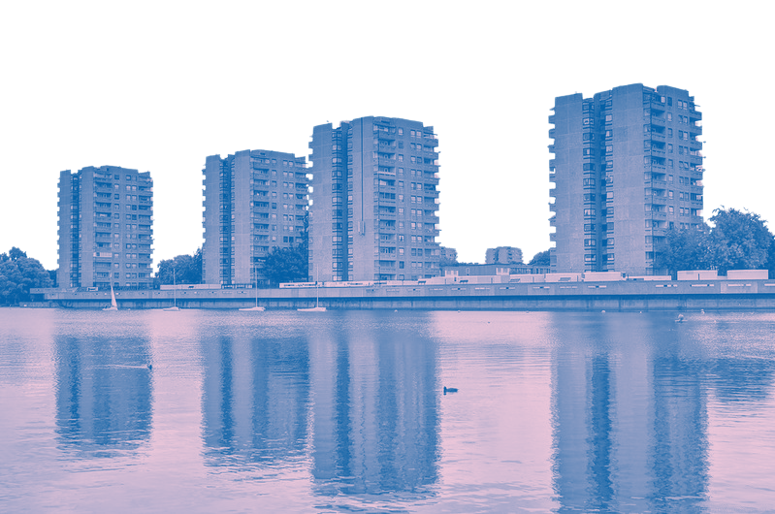
Failing Utopia
The persistent neglect of Thamesmead and its working-class community

Slide 2
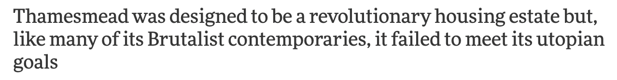
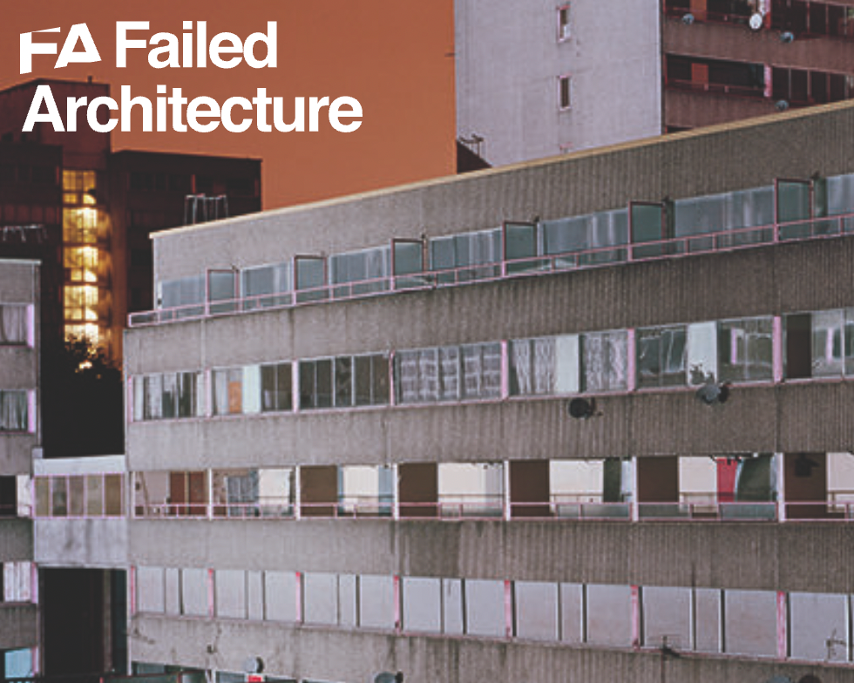
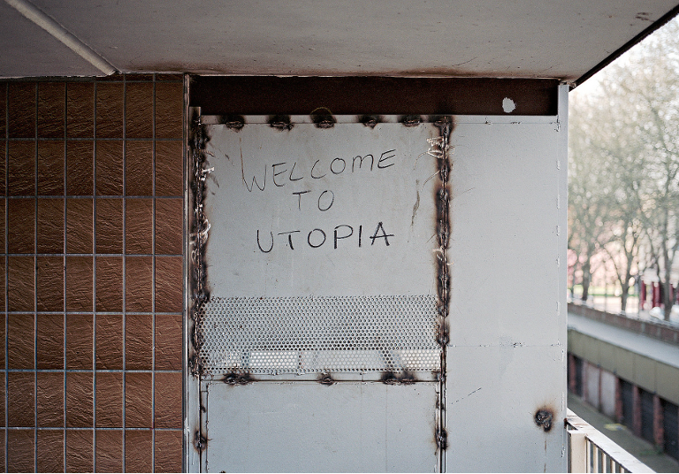
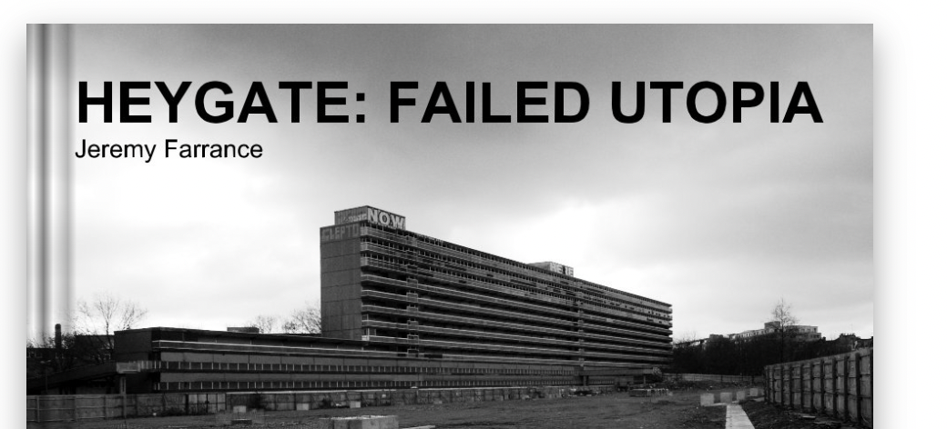
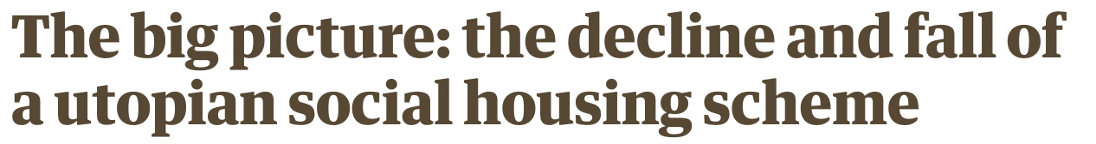
The concept of ‘Failed Utopia’

Slide 3
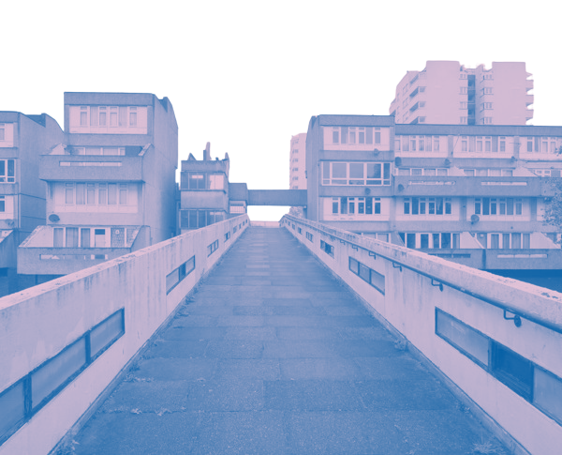
Thamesmead
Late 60's - early 80s Thamesmead was built, managed by GLC
Problems from the start, families were moved in from crowded homes in South East London when it was still a building site and felt isolated
Awards won for architecture, plans for transport links and town centre abandoned
1979 Margaret Thatcher’s Conservative Government
Beginning of decline for social homes as Thatcher’s government put sanctions in place on funds for councils to carry out repairs and maintenance
1986 GLC dissolved
Thamesmead recorded to be in ‘steep decline’
This is where the failings are seen to have happened, and that Thamesmead is in a continuous state

Slide 4
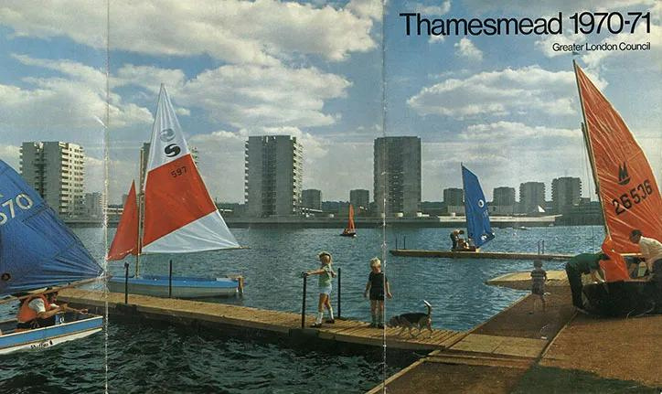
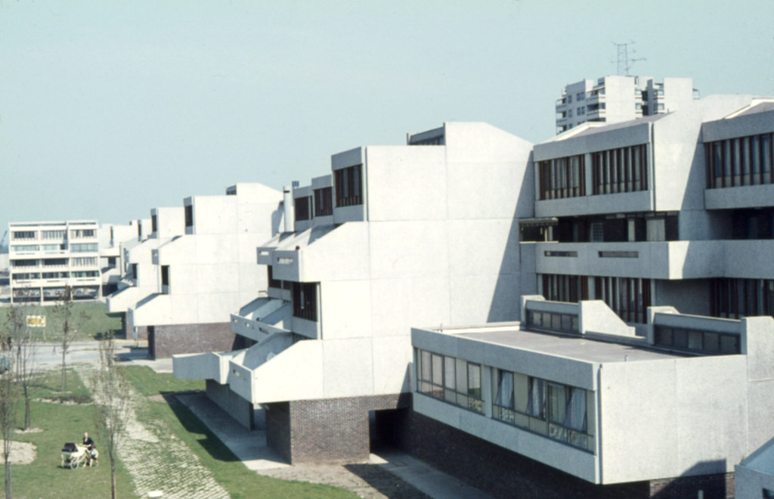
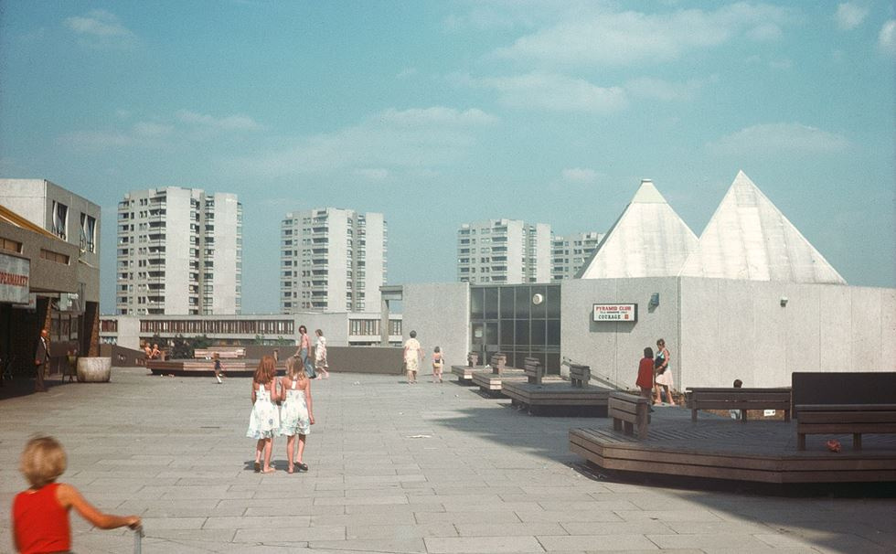
Thamesmead built 1967 - 1983

Slide 5
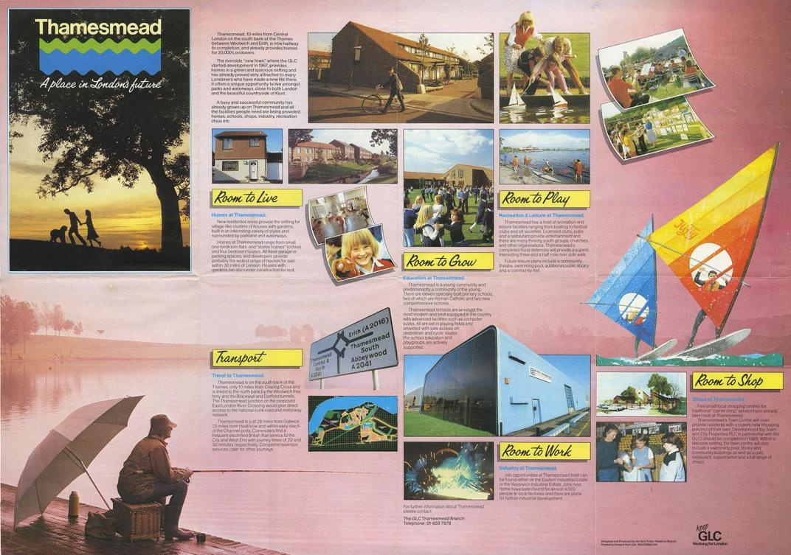
GLC leaflet 1982

Slide 6
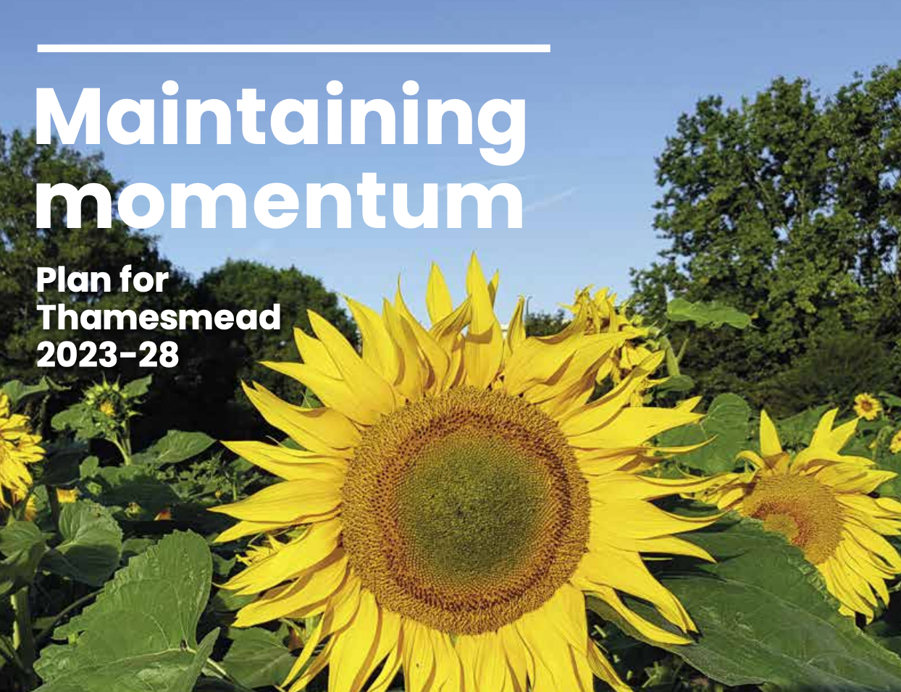
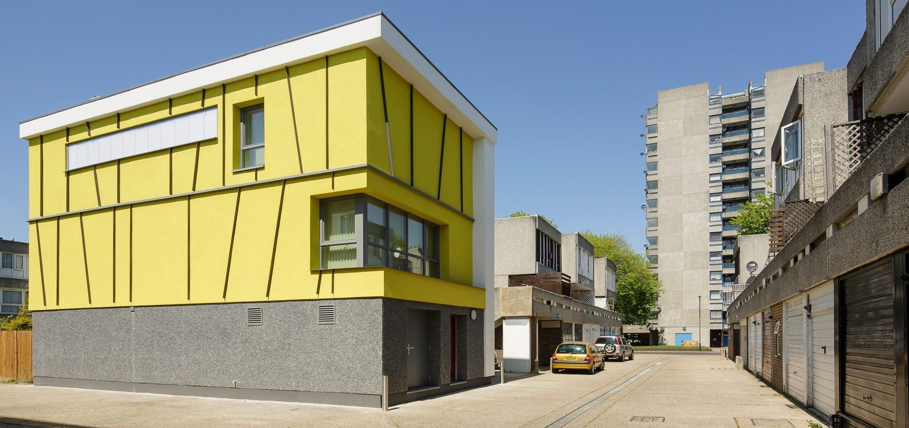


Peabody

Slide 7
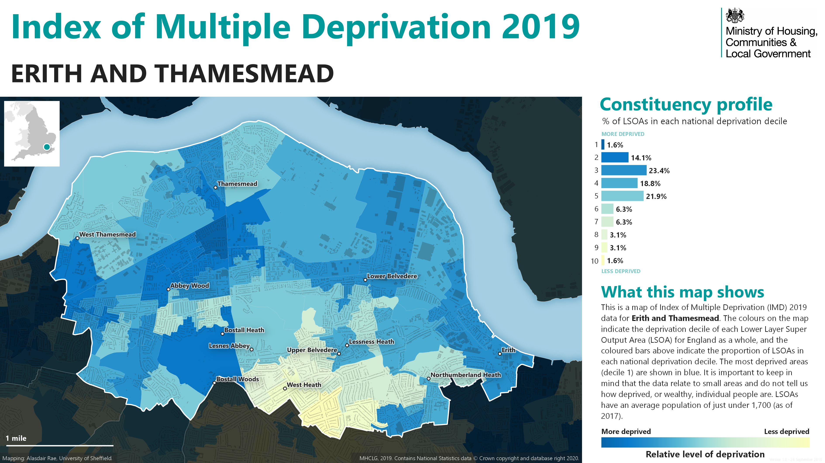
Phase 3
Thamesmead Moorings
Greenwich
Phase 1&2
Thamesmead East
Bexley

Slide 8
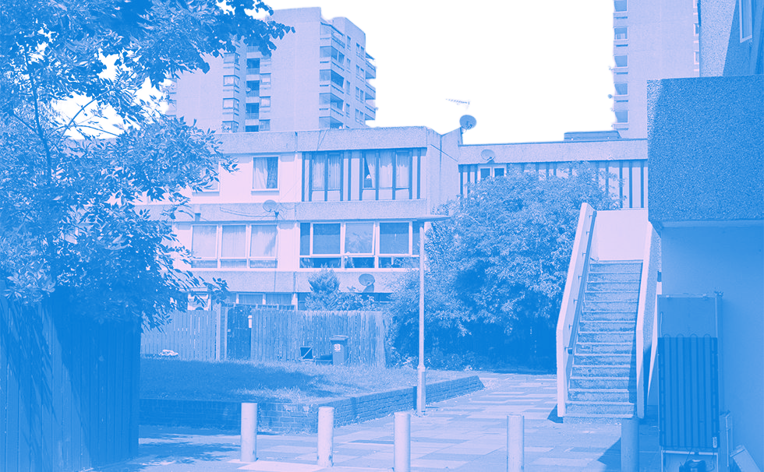
Socioeconomic profile
45,000+ residents
2011 census found that only 36% of people were in full-time work
63% of its residents from BAME groups, compared to the London average of 55%
Home to London’s largest local authority Traveller site, Thistlebrook
In 2016 HMRC research found that child poverty had reduced in the last five years but is still higher than across London with 21% of children in The Moorings ward living in poverty

Slide 9
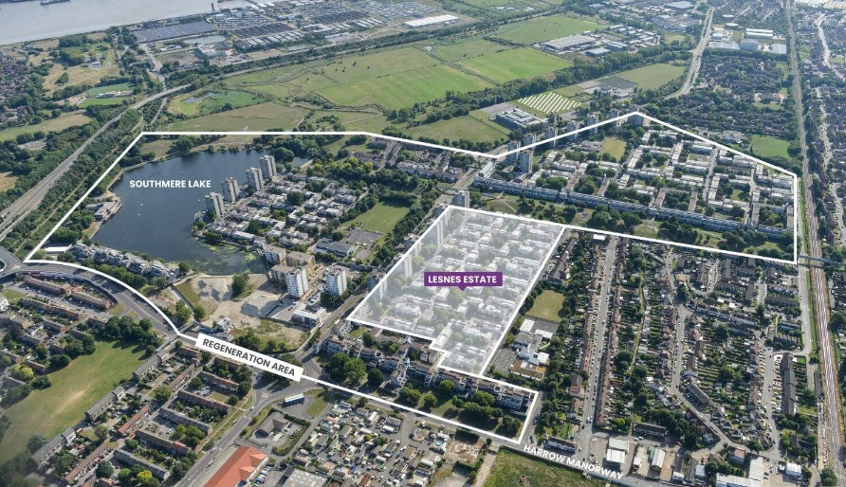
Phase 1&2
Thamesmead East, Bexley

Slide 10
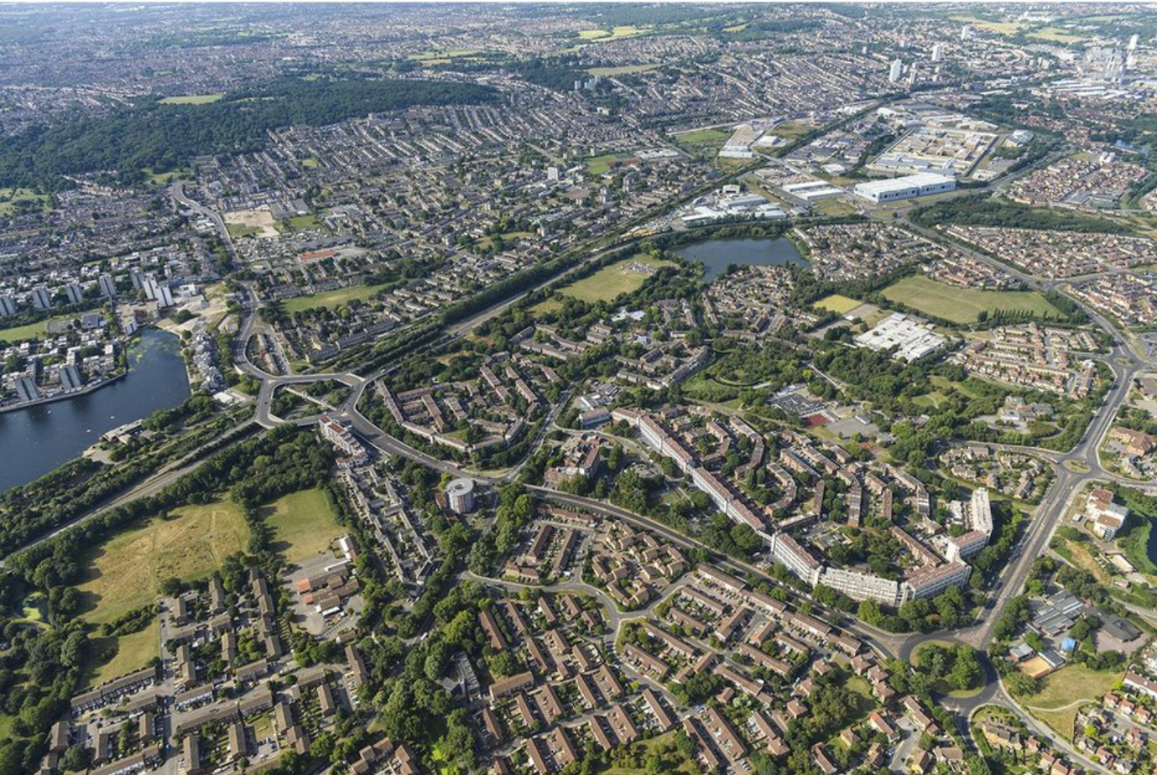
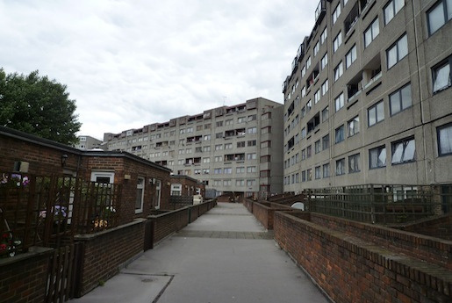
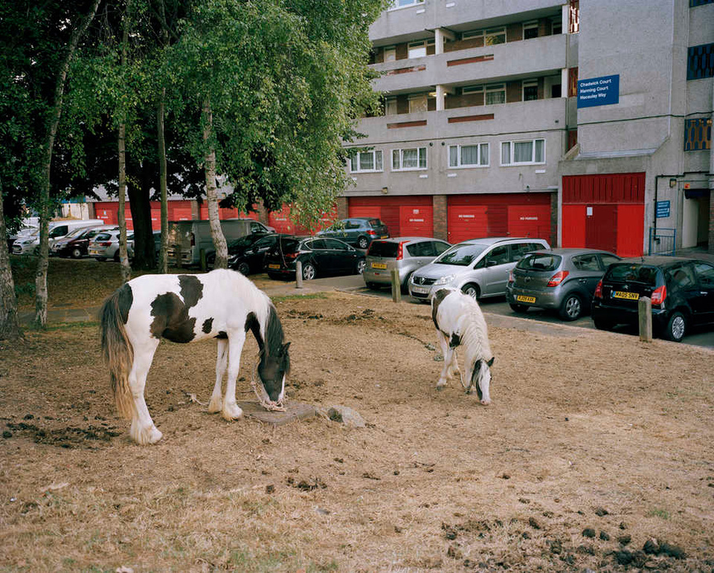
Phase 3
Thamesmead Moorings
Greenwich

Slide 11
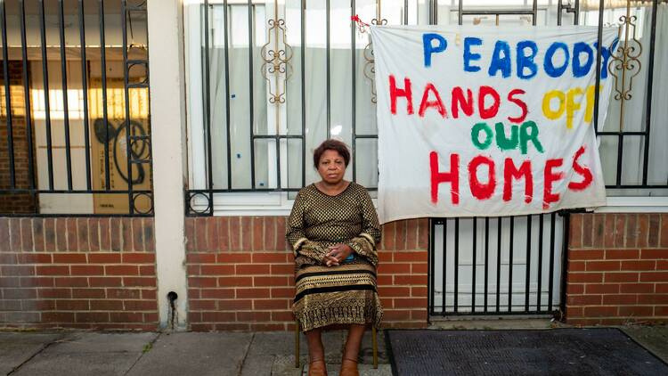
Failing
Utopia
The failings are not finished, it is an ongoing process
Poverty and evidence of advanced marginality
Basic amenities not built/closed down and not replaced
Ongoing neglect and failings of residents’ needs

Slide 12
Interviewees
Resident 1
Lived in Thamesmead since 1988
Lives in Phase 3
Now disabled, waiting to be allocated appropriate housing by Peabody but wants to leave Thamesmead
Resident 2
Lived in Thamesmead for 10 years
Leaseholder in new development
Worked on community projects with Bow Arts and Peabody
Now in the process of suing Peabody and Bow Arts
Resident 3
Born and raised in Thamesmead
Lived in Phase 2 for 27 years
Ended up homeless, now lives in Durham
Resident 4
Lived in Thamesmead for 7 years
Leaseholder on the river in Thamesmead West ward
Involved in community arts projects

Slide 13
Themes
‘It’s making things worse’
Poverty
Art washing and Gentrification
Social Exclusion

Slide 14
Poverty
Only 50% of residents have access to internet
These people are time-poor, hard to reach
Thamesmead is home to the UK’s largest under 18's population
Isolated and hyper-local communities
‘Tale of two cities’
Residents are ‘crying in supermarkets’ because they can’t afford food

Slide 15
‘It’s making things worse’
‘Peashoddy’
New builds ‘not fit for purpose’
Overwhelming local infrastructure
Lack of maintenance
‘Designing crime in’
‘They only care about the money’

Slide 16
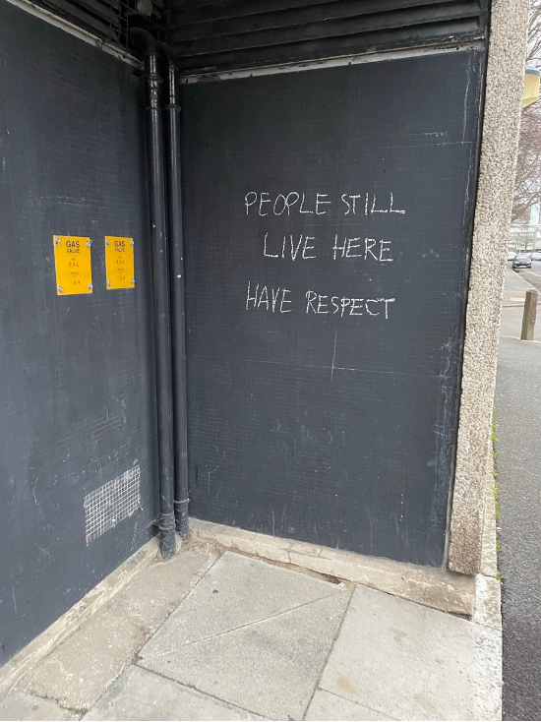
Degeneration
Multiple residents report on other people in the area not caring about the estate anymore
That it’s turned into a ‘dog toilet’ and ‘really dire’
Lack of maintenance done in previous decades but Peabody are continuing to ignore residents
Steep decline in the past 10 years of how safe and comfortable people feel
‘The reality of regeneration for residents involved multiple layers of physical, social, symbolic and psychosocial ‘degeneration’’ (Watt, 2023:351)

Slide 17
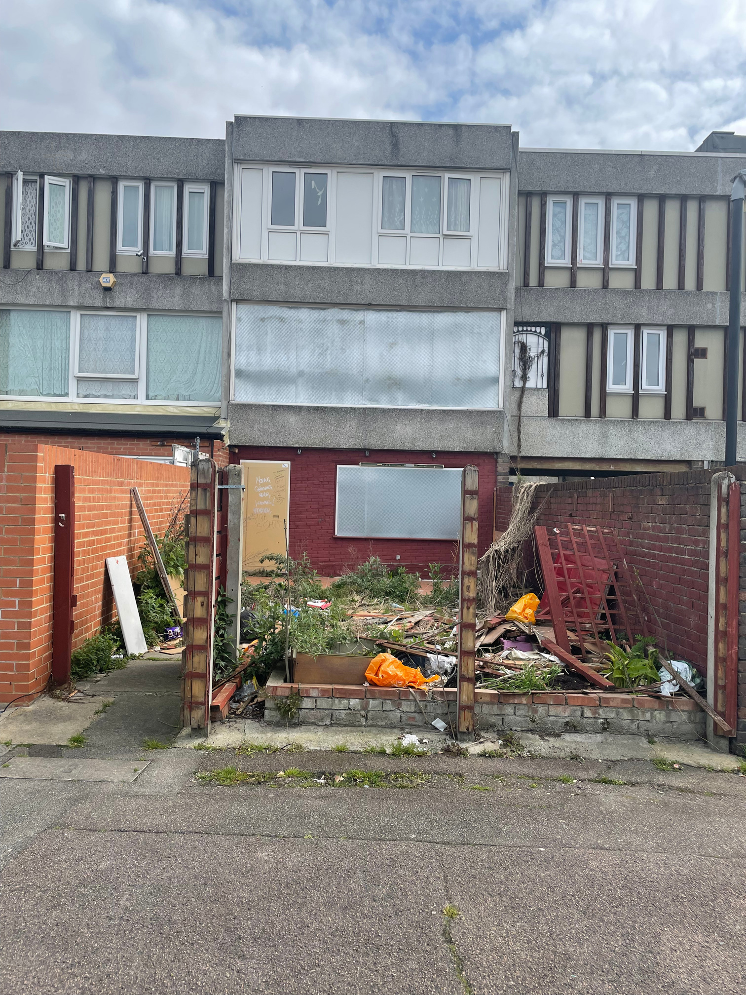
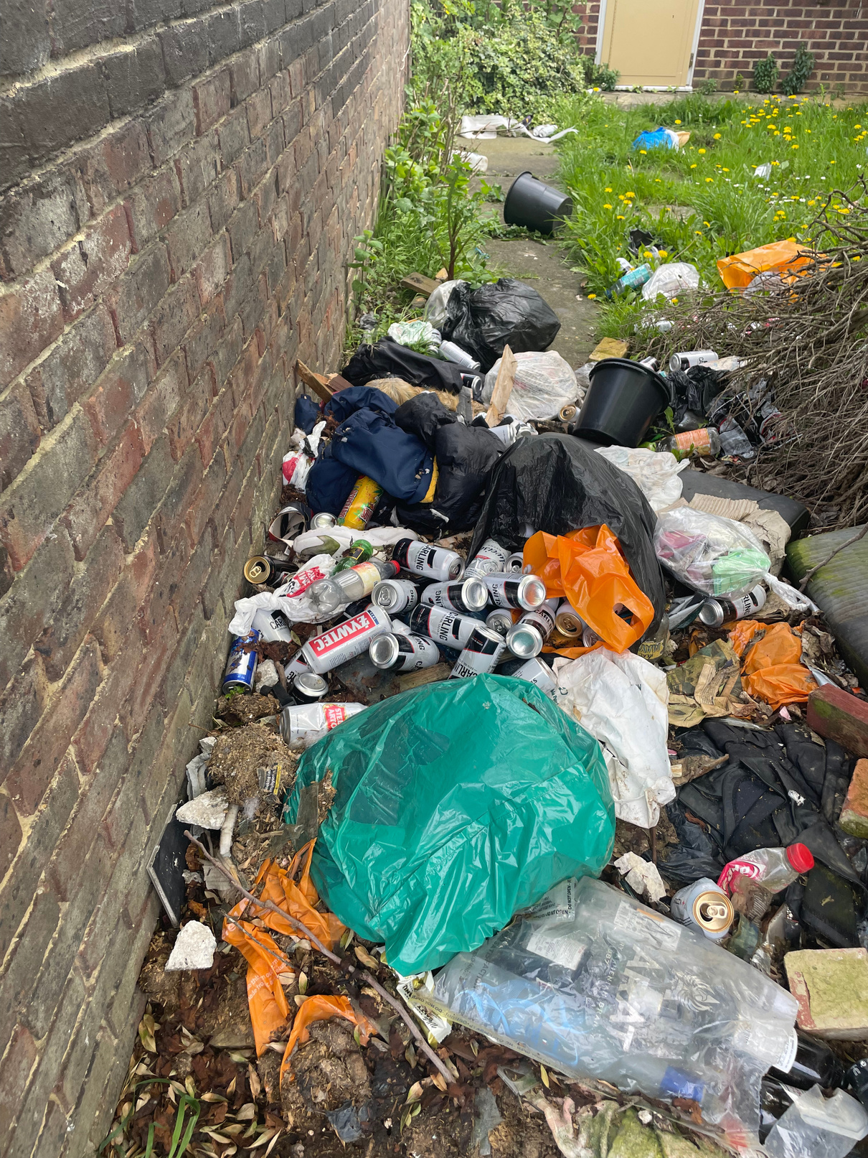
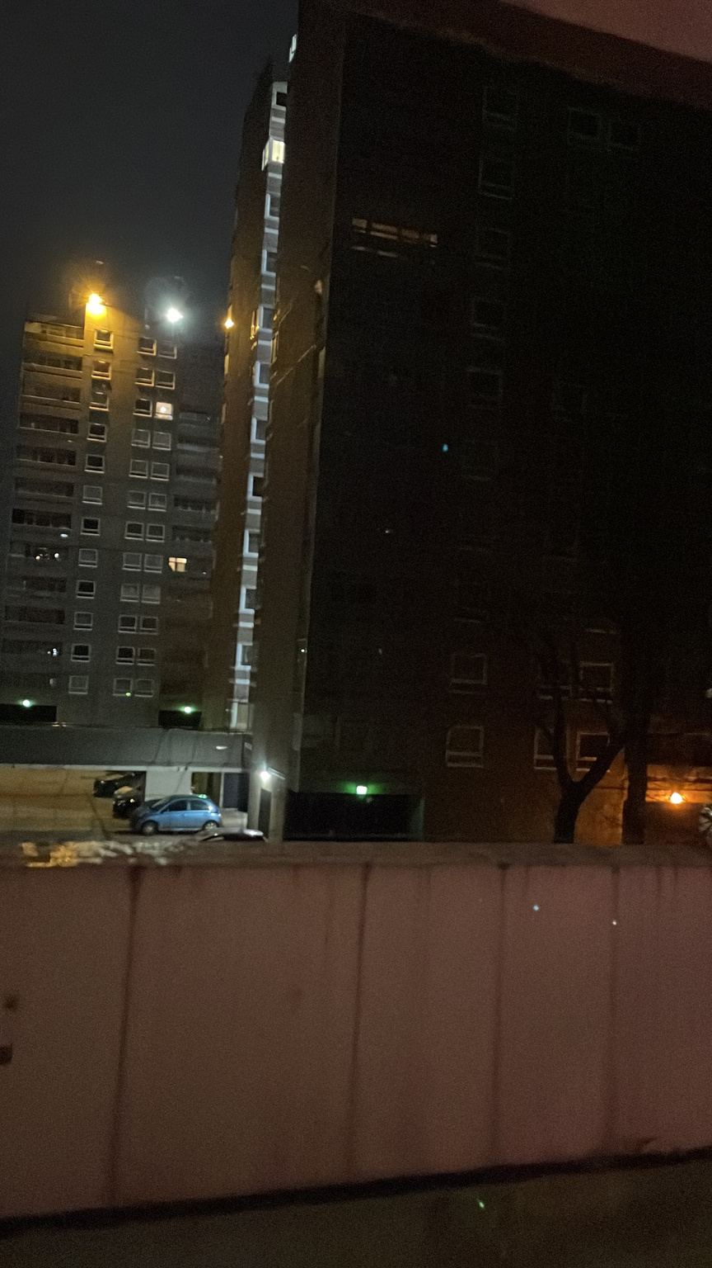
‘Regeneration’s demonic alter ego in the form of financial disinvestment in those areas and their accelerated physical, social and symbolic deterioration over and above any original problems they might have’ (Watt, 2021:263)

Slide 18
Crime
The three residents who live/lived on the estate said there had been a noticeable increase in crime in the past 10/15 years
Multiple residents describe traumatic personal experiences with crime
Resident 2 states that crime has been designed into the new builds and has been attacked multiple times
Resident 1 won’t go out at night after one of her assistant dogs got attacked
Resident 3 lives with PTSD due to increased crime levels on the estate from the late 2000s
Resident 3 mentions that the crime increase was due to the merging of another nearby estate that was notorious for crime

Slide 19
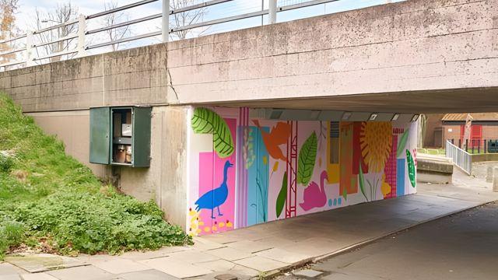
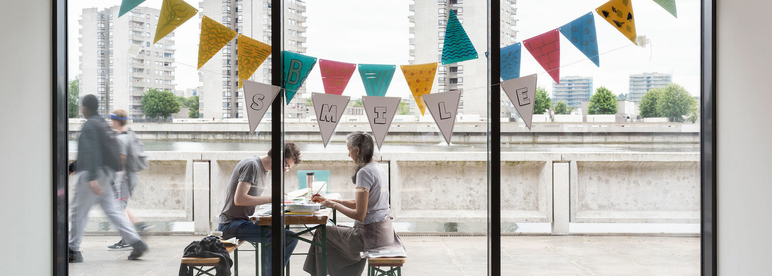
Art washing and Gentrification
Bow Arts’ Lakeside Centre Shortlisted for The Pineapples Awards in 2023
Renovations of the building have been funded by City Hall’s Regeneration Fund, with support from the London Economic Action Partnership (LEAP), Peabody, Bow Arts and Arts Council England

Slide 20
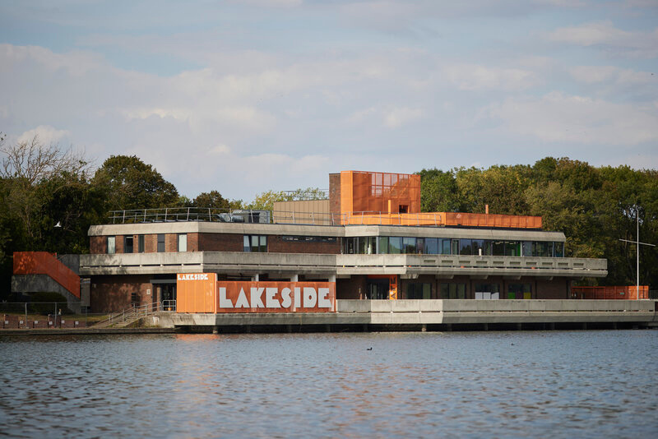
‘Thamesmead residents are invited to the iconic Lakeside Centre on Tuesday 10 May for a special open studios event, celebrating the building’s £2.7m refurbishment.’
‘People are really poor here, this is not what they need’

Slide 21
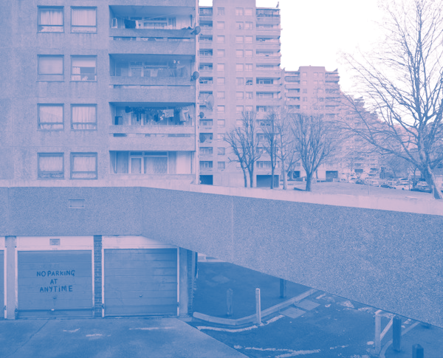
Social Exclusion
Local infrastructure is overwhelmed, hard to book doctors and dentist appointments
The only cafe was the Morrisons cafe, which has now closed
Retail parks have empty spaces
Youth Centres closed down or under-utilised
The only late-night establishment is the Cutty Sark pub
Thamesmead festival which caters for vulnerable and low-income families

Slide 22
Social Exclusion
‘Social exclusion, a broader concept which usually implies that some people or households are not just poor, but that they have additionally lost the ability to both literally and metaphorically connect with many of the jobs, services, and facilities that they need to participate fully in society.’ (Church et al, 2000:197)
Physical Exclusion
Geographic Exclusion
Exclusion from facilities
Economic Exclusion

